Slide 1

Using Cloud Top Temperature for the forecast of Cyclone track using Machine Learning approach
By- Vrishabh Kenkre
Under supervision of
Dr. Srinivasa Ramanujam Kannan

Slide 2
Agenda
Introduction
Objective
Progress till now
References

Slide 3
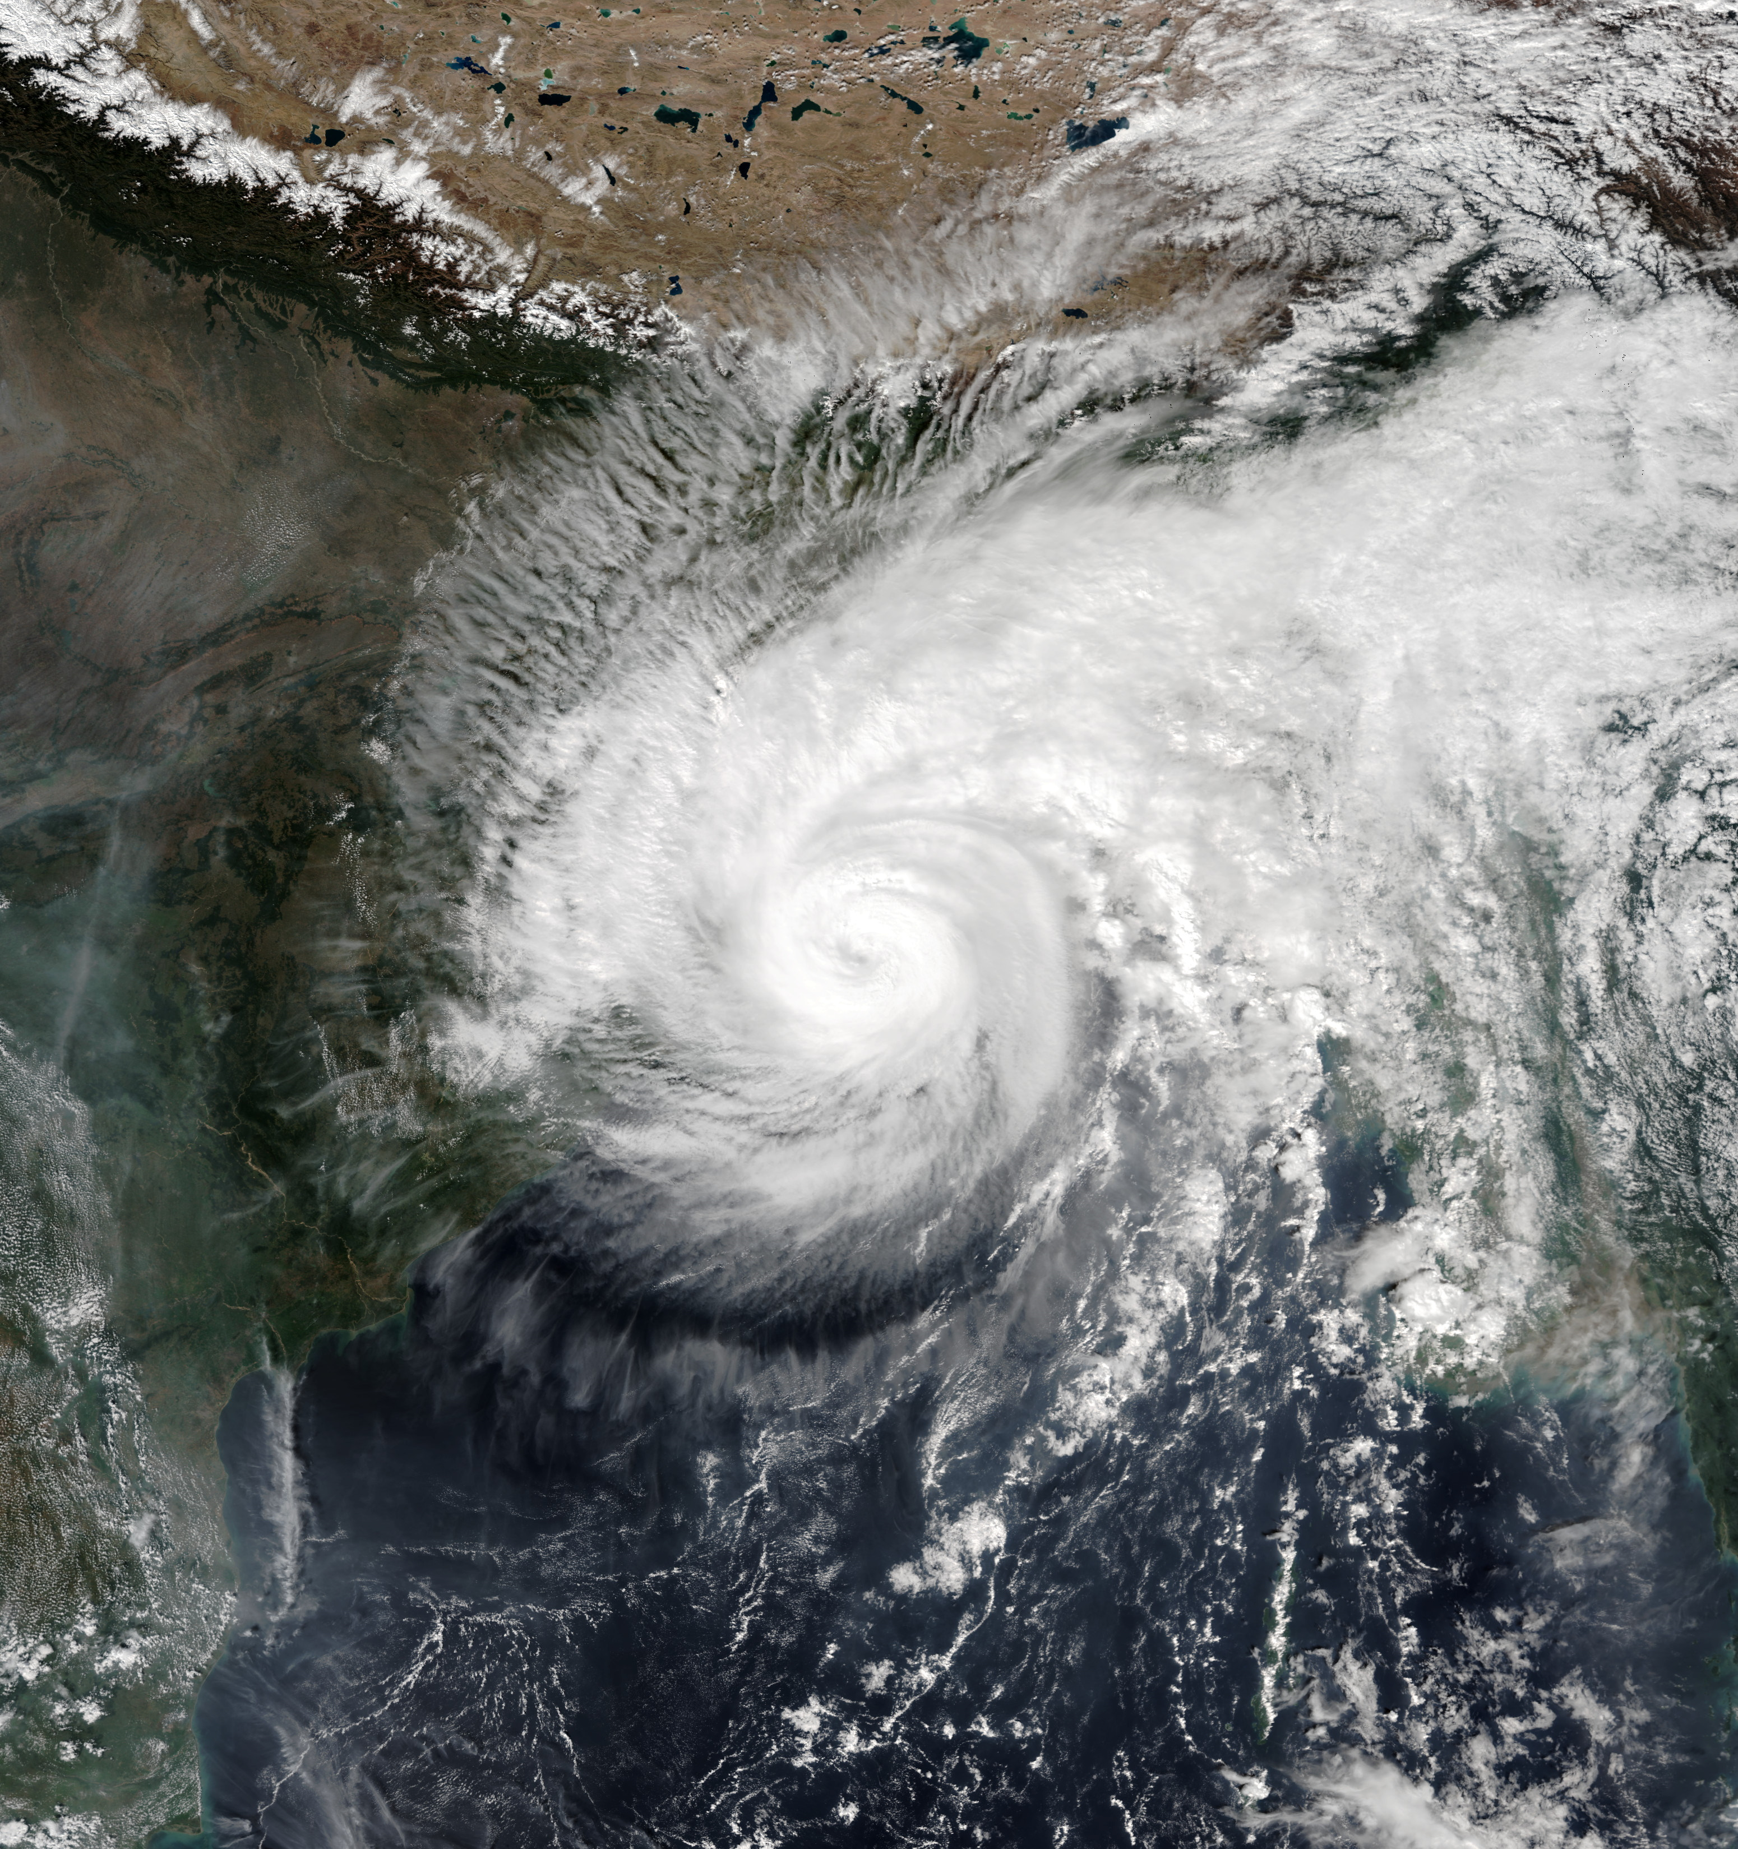
Introduction
Tropical cyclone forecasting is the science of forecasting where a tropical cyclone's center, and its effects, are expected to be at some point in the future.
https://en.wikipedia.org/wiki/Cyclone_Matmo%E2%80%93Bulbul

Slide 4
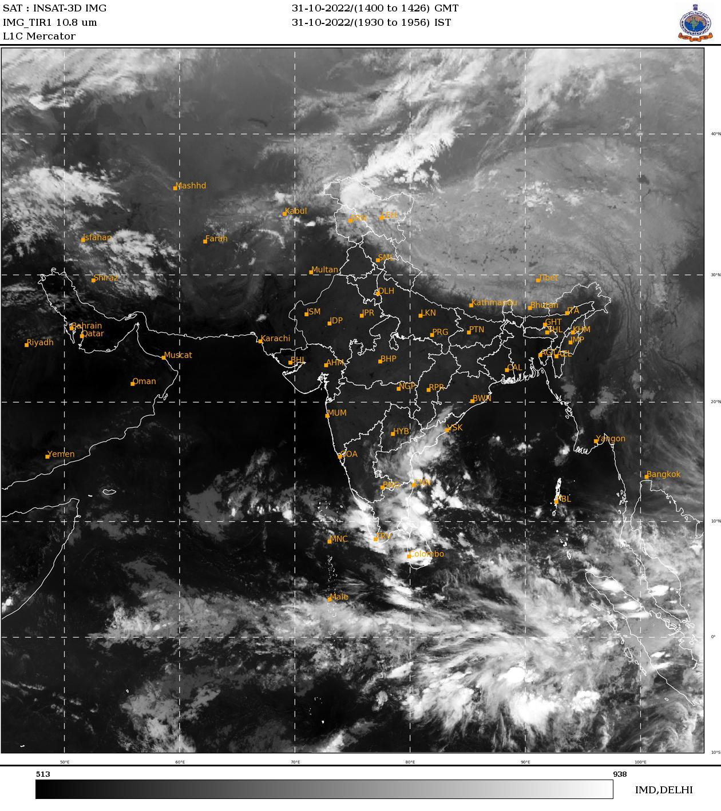
Objective
To predict the occurrence of cyclone at minimum of 5-7 days before its arrival with sufficient accuracy from satellite image data.
https://www.mosdac.gov.in/

Slide 5
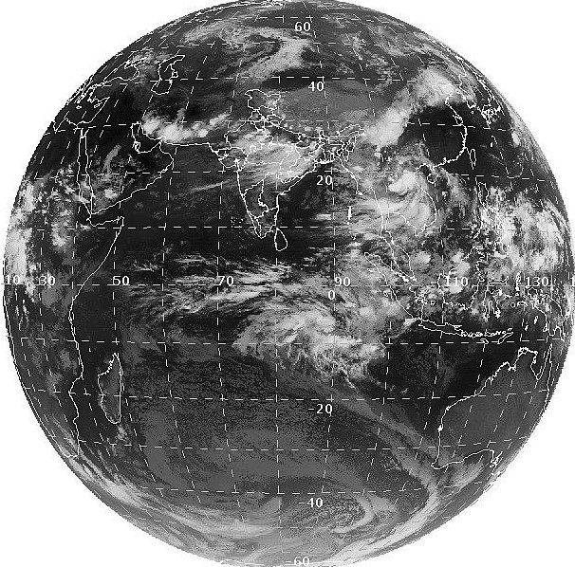
Data extraction and trimming
Data is obtained from INSAT 3D satellite.
After the data was extracted, it was trimmed to get the region surrounding India.
Data of 15 days, 5-7 days before landfall, hence 3- dimensional data.
3-D data has 2-dimensions of space and 1-Time.
https://www.eoportal.org/satellite-missions/insat-3d#spacecraft

Slide 6
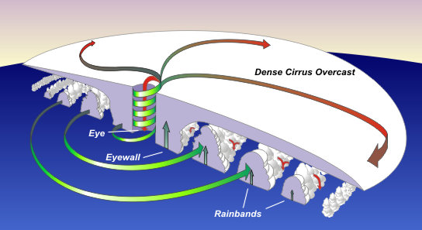
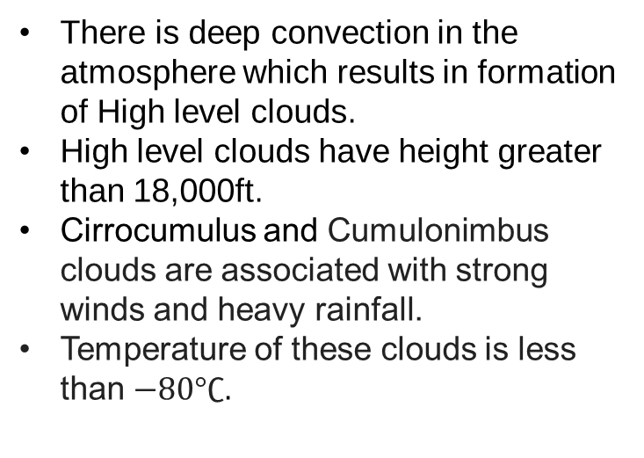
Why Tall and Ice clouds?
There is deep convection in the atmosphere which results in formation of High level clouds.
High level clouds have height greater than 18,000ft.
Cirrocumulus and Cumulonimbus clouds are associated with strong winds and heavy rainfall.
Temperature of these clouds is less than $−80°∁$.
https://www.weather.gov/jetstream/tc_structure

Slide 7
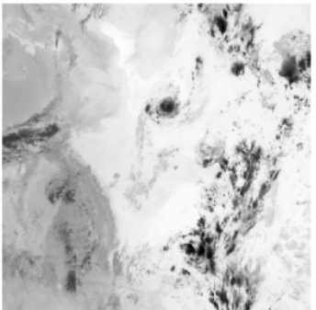
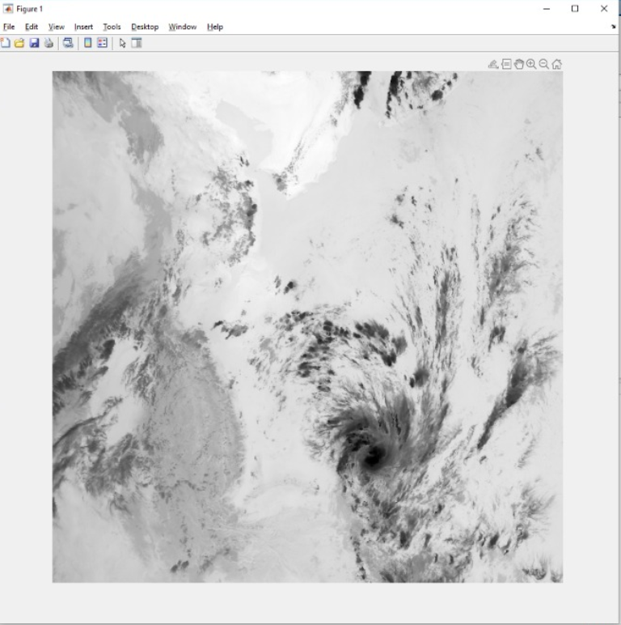
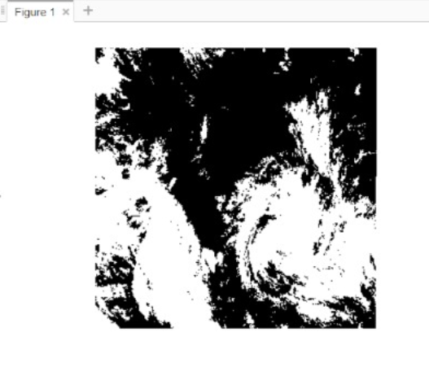
Images on day of Landfall
Amphan
Bulbul
Hudhud
Here the dark regions are represented by clouds of lower temperature.

Slide 8
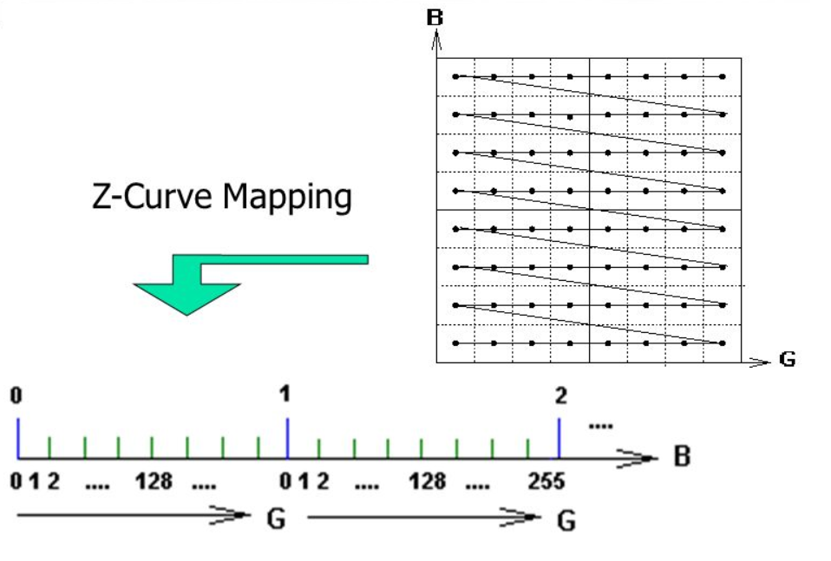
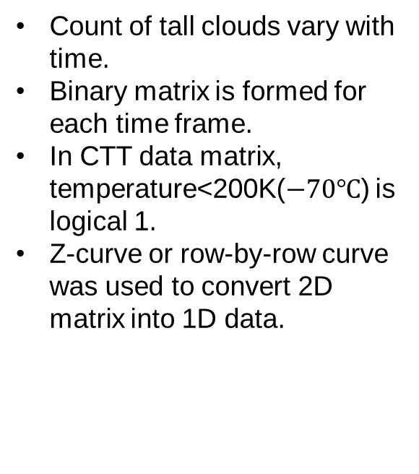
Dimensionality Reduction
Count of tall clouds vary with time.
Binary matrix is formed for each time frame.
In CTT data matrix, temperature<200K($−70℃$) is logical 1.
Z-curve or row-by-row curve was used to convert 2D matrix into 1D data.

Slide 9
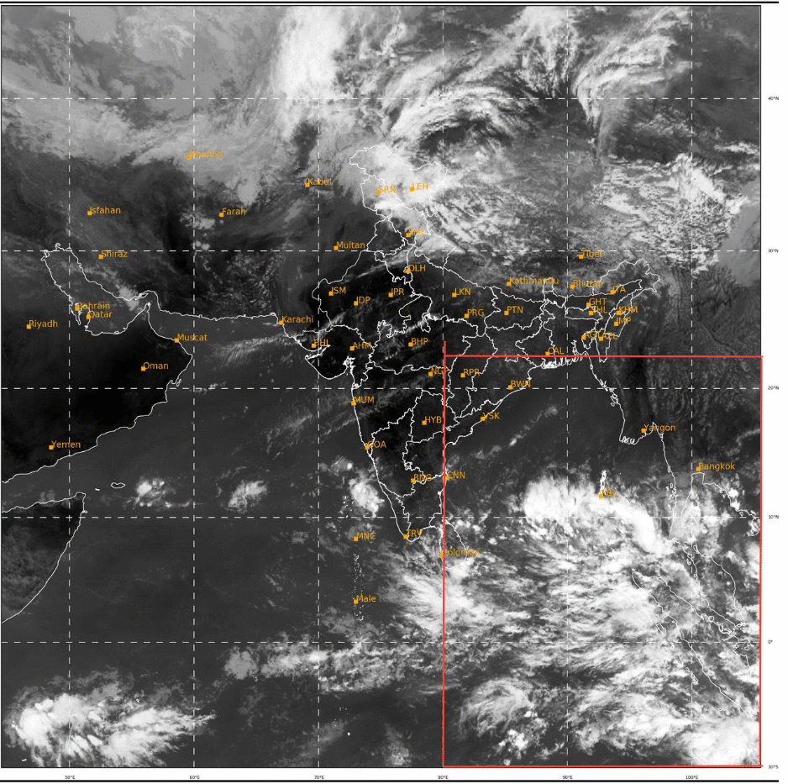
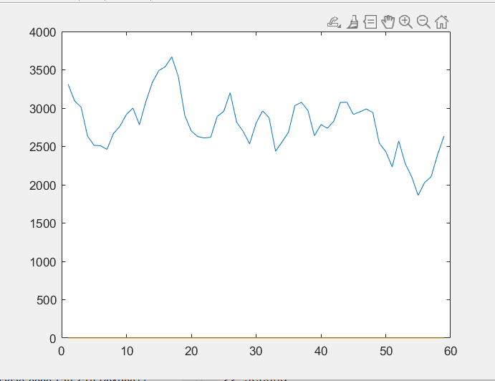
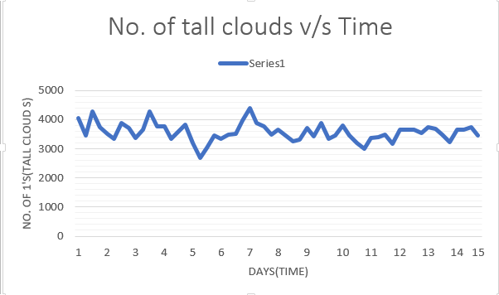
Spread of Tall clouds
Check the spread of tall clouds
Group the nearby logical 1’s together.
Nearby pixels form a single cloud.
Plotted its count for 15 days.
Targeted only bay of Bengal area for better results.
https://mosdac.gov.in/
V/S
Bulbul
Deep depression BoB-3

Slide 10
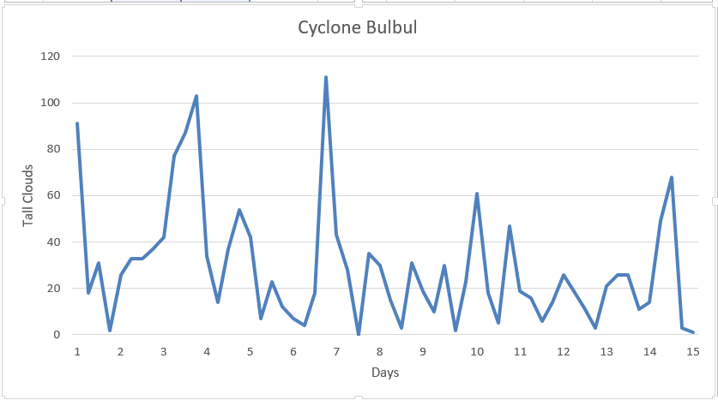
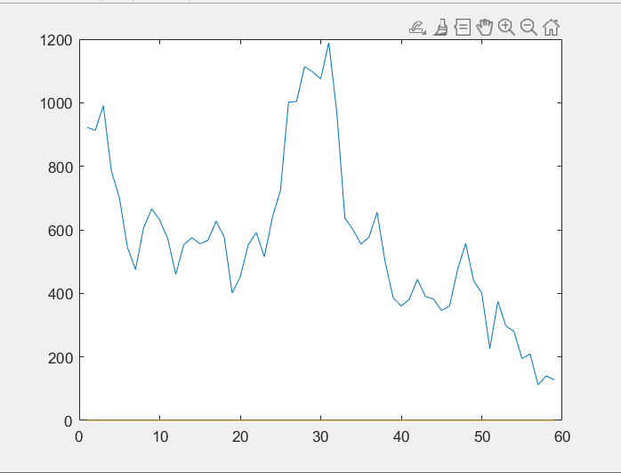
After targeting BoB
Bulbul
Amphan

Slide 11
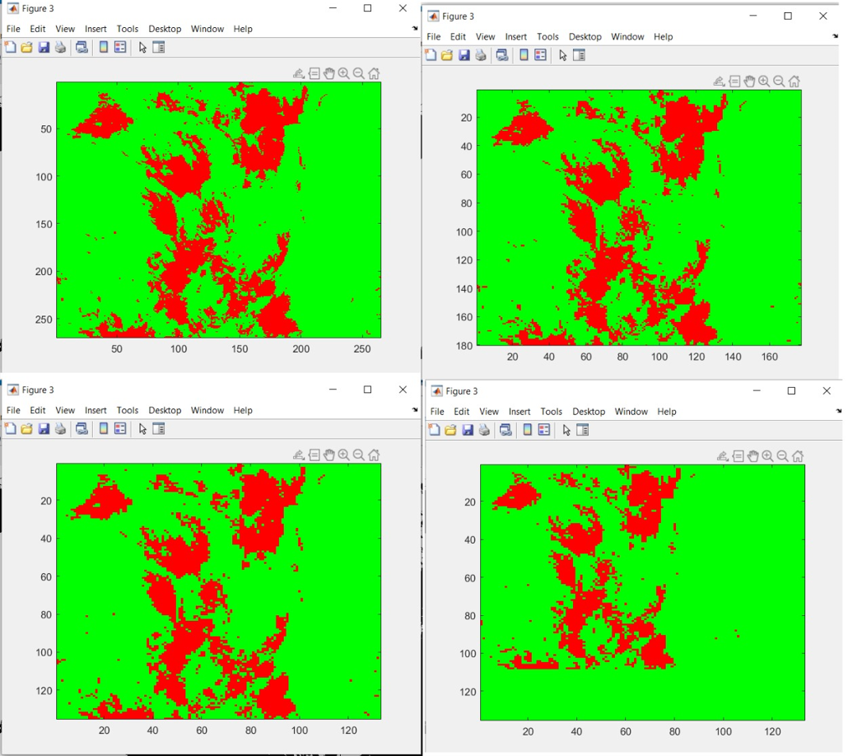
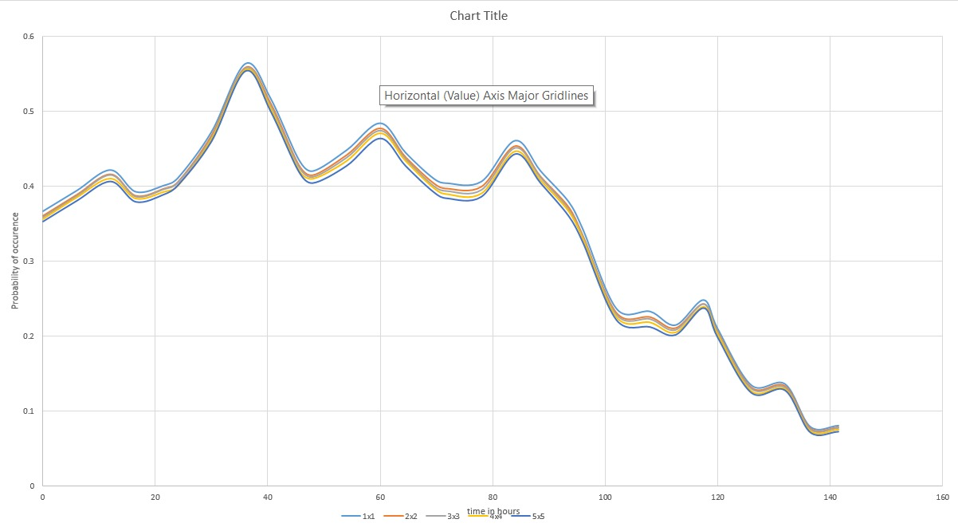
Clustering
2x2
3x3
Marked one pixel as 1 cloud, now we group them in matrices of 2x2, 3x3, 4x4 and 5x5.
Plotted them for Bulbul, Hudhud, Amphan.
4x4
5x5
Amphan

Slide 12
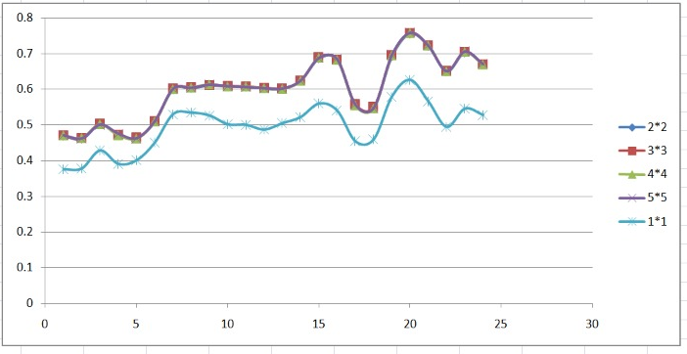
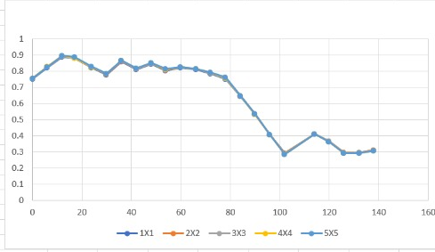
Comparisions
When a cyclone gains strength, more ice clouds will appear.
When dipping, it should continuously dip as it moves towards coast. because the cyclone gets cut off from moisture source.
Phetai
Hudhud

Slide 13
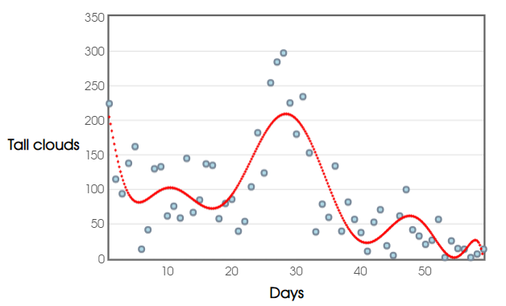
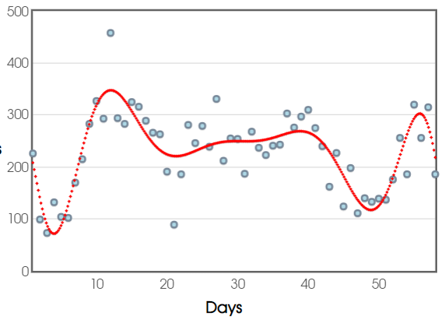
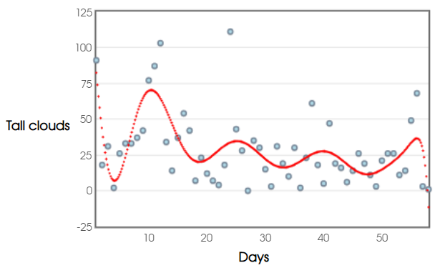
Finding a trend in data
Further classification into tall medium and low clouds.
Scatter plot for all 3 were made and trend fitting the best was found.
Cyclone Amphan
Middle clouds
Cyclone Bulbul
Cyclone Bulbul

Slide 14
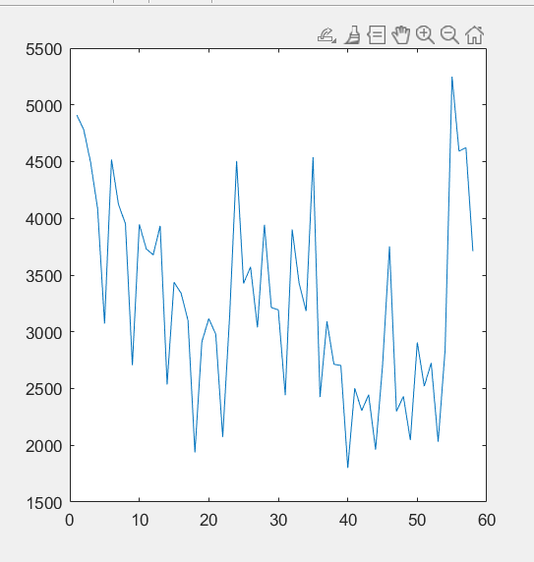
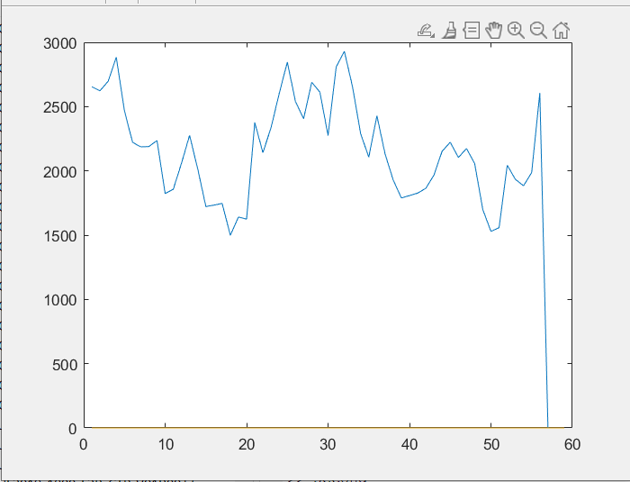
Spatial variation of Ice Clouds
Comparing the count of tall clouds with spatial variation of Ice clouds.
Bulbul
Deep Depression

Slide 15

Spatial variation of Ice Clouds

Slide 16
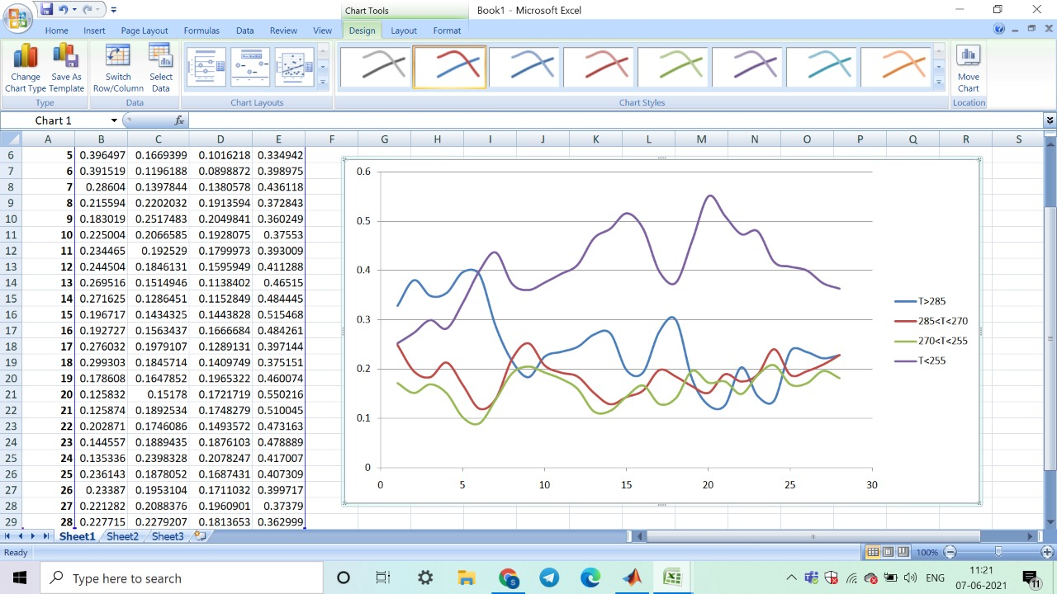
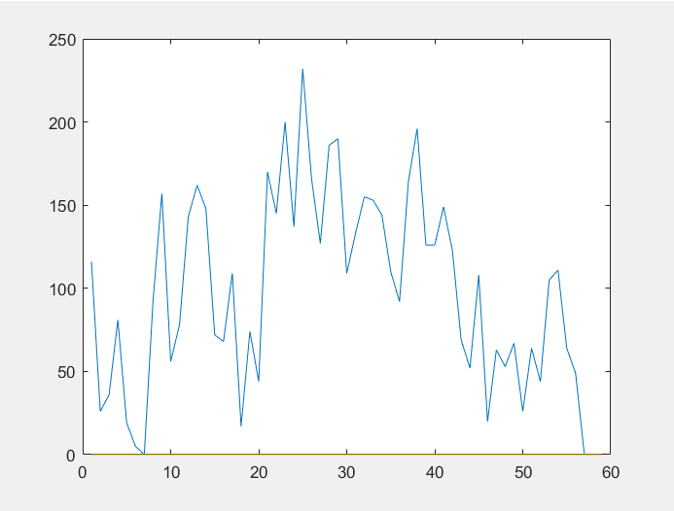
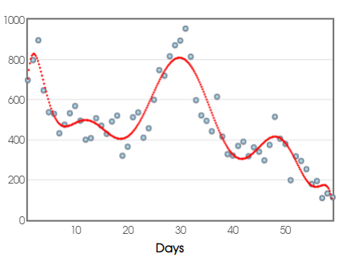
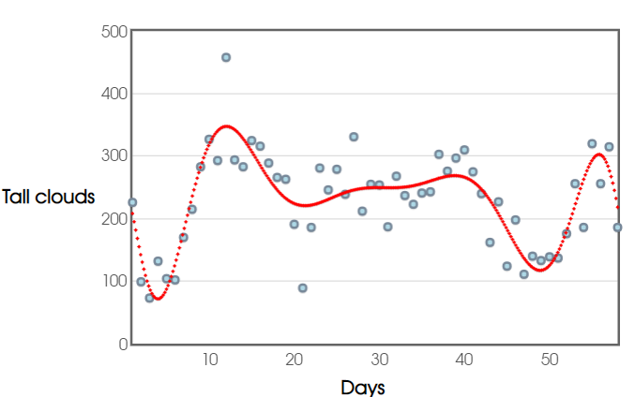
Appendix
Phetai
Deep depression BoB-3
Middle clouds
Amphan
Bulbul

Slide 17
References
https://www.mosdac.gov.in/
https://en.wikipedia.org/wiki/Cyclone_Matmo%E2%80%93Bulbul
https://in.mathworks.com/matlabcentral/answers/876108-how-to-display-subplot-with-multiple-image-with-its-own-x-and-y-axes
https://in.mathworks.com/matlabcentral/answers/493067-how-to-add-different-titles-to-multiple-image-display-using-subplot
https://matplotlib.org/stable/gallery/images_contours_and_fields/image_demo.html
https://stackoverflow.com/questions/18266642/multiple-imshow-subplots-each-with-colorbar
https://www.investopedia.com/terms/r/regression.asp
https://www.researchgate.net/publication/332651207_Multidimensional_data_structures_usage_in_adaptive_data_storages/figures?lo=1
https://slideplayer.com/slide/8079786/
https://economictimes.indiatimes.com/news/science/insat-3d-helped-in-tracking-cyclone-hudhud-accurately-imd/articleshow/44924254.cms?from=mdr

Slide 18




Thank you
Vrishabh Kenkre
kvb12@iitbbs.ac.in
School of Mechanical Sciences

